Slide 1
LECTURE 1
FIRST SEMESTER SE 2019

Slide 2
Software is a program or set of programs containing instructions which provide desired functionality . And Engineering is the processes of designing and building something that serves a particular purpose and find a cost effective solution to problems.
Engineering on the other hand, is all about developing products, using well-defined, scientific principles and methods.

Slide 3
Software Engineering is a systematic approach to the design, development, operation, and maintenance of a software system.
Software engineering is an engineering branch associated with development of software product using well-defined scientific principles, methods and procedures. The outcome of software engineering is an efficient and reliable software product.

Slide 4
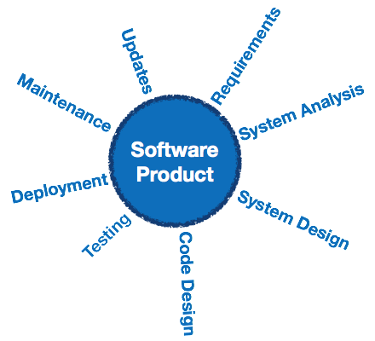

Slide 5
Dual Role of Software:
1. As a product –
It delivers the computing potential across network of Hardware.
It enables the Hardware to deliver the excepted functionality.
It acts as information transformer because it produces, manages, acquires, modifies, displays, or transmits information.
2. As a vehicle for delivering a product –
It provides system functionality (e.g., payroll system)
It controls other software (e.g., an operating system)
It helps build other software (e.g., software tools)

Slide 6
Objectives of Software Engineering:
Maintainability – It should be feasible for the software to evolve to meet changing requirements.
Correctness – A software product is correct, if the different requirements as specified in the SRS document have been correctly implemented.
Reusability – A software product has good reusability, if the different modules of the product can easily be reused to develop new products.
Testability – Here software facilitates both the establishment of test criteria and the evaluation of the software with respect to those criteria.

Slide 7
Objectives of Software Engineering:
Reliability – It is an attribute of software quality. The extent to which a program can be expected to perform its desired function, over an arbitrary time period.
Portability – In this case, software can be transferred from one computer system or environment to another.
Adaptability – In this case, software allows differing system constraints and user needs to be satisfied by making changes to the software.

Slide 8
Program vs Software Product:
Program is a set of instruction related each other where as Software Product is a collection of program designed for specific task.
Programs are usually small in size where as Software Products are usually large in size.
Programs are developed by individuals that means single user where as Software Product are developed by large no of users.
In program, there is no documentation or lack in proper documentation. In Software Product, Proper documentation and well documented and user manual prepared.

Slide 9
Program vs Software Product:
Development of program is Unplanned, not Systematic etc but Development of Software Product is well Systematic, organized, planned approach.
Programs provide Limited functionality and less features where as Software Products provides more functionality as they are big in size (lines of codes) more options and features.

Slide 10
Software Evolution
The process of developing a software product using software engineering principles and methods is referred to as software evolution. This includes the initial development of software and its maintenance and updates, till desired software product is developed, which satisfies the expected requirements.

Slide 11
Evolution starts from the requirement gathering process. After which developers create a prototype of the intended software and show it to the users to get their feedback at the early stage of software product development. The users suggest changes, on which several consecutive updates and maintenance keep on changing too. This process changes to the original software, till the desired software is accomplished.
Even after the user has desired software in hand, the advancing technology and the changing requirements force the software product to change accordingly. Re-creating software from scratch and to go one-on-one with requirement is not feasible. The only feasible and economical solution is to update the existing software so that it matches the latest requirements.

Slide 12
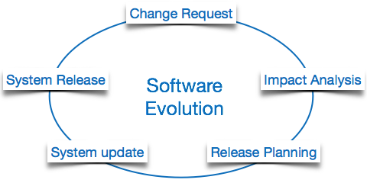

Slide 13
Software Evolution Laws
Lehman has given laws for software evolution. He divided the software into three different categories:
S-type (static-type) - This is a software, which works strictly according to defined specifications and solutions. The solution and the method to achieve it, both are immediately understood before coding. The s-type software is least subjected to changes hence this is the simplest of all. For example, calculator program for mathematical computation.

Slide 14
P-type (practical-type) - This is a software with a collection of procedures. This is defined by exactly what procedures can do. In this software, the specifications can be described but the solution is not obvious instantly. For example, gaming software.
E-type (embedded-type) - This software works closely as the requirement of real-world environment. This software has a high degree of evolution as there are various changes in laws, taxes etc. in the real world situations. For example, Online trading software.

Slide 15
E-Type software evolution
Lehman has given eight laws for E-Type software evolution -
Continuing change - An E-type software system must continue to adapt to the real world changes, else it becomes progressively less useful.
Increasing complexity - As an E-type software system evolves, its complexity tends to increase unless work is done to maintain or reduce it.
Conservation of familiarity - The familiarity with the software or the knowledge about how it was developed, why was it developed in that particular manner etc. must be retained at any cost, to implement the changes in the system.

Slide 16
Continuing growth- In order for an E-type system intended to resolve some business problem, its size of implementing the changes grows according to the lifestyle changes of the business.
Reducing quality - An E-type software system declines in quality unless rigorously maintained and adapted to a changing operational environment.
Feedback systems- The E-type software systems constitute multi-loop, multi-level feedback systems and must be treated as such to be successfully modified or improved.
Self-regulation - E-type system evolution processes are self-regulating with the distribution of product and process measures close to normal.
Organizational stability - The average effective global activity rate in an evolving E-type system is invariant over the lifetime of the product.

Slide 17
Software Paradigms
Software paradigms refer to the methods and steps, which are taken while designing the software. There are many methods proposed and are in work today, but we need to see where in the software engineering these paradigms stand. These can be combined into various categories, though each of them is contained in one another

Slide 18
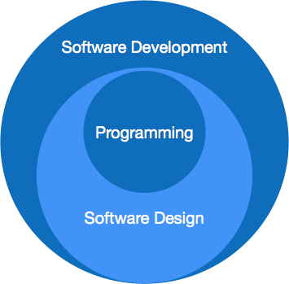
Programming paradigm is a subset of Software design paradigm which is further a subset of Software development paradigm.

Slide 19
Software Development Paradigm
This Paradigm is known as software engineering paradigms where all the engineering concepts pertaining to the development of software are applied. It includes various researches and requirement gathering which helps the software product to build. It consists of –
Requirement gathering
Software design
Programming

Slide 20
Software Design Paradigm
This paradigm is a part of Software Development and includes –
Design
Maintenance
Programming
Programming Paradigm
This paradigm is related closely to programming aspect of software development. This includes –
Coding
Testing
Integration

Slide 21
Need of Software Engineering
The need of software engineering arises because of higher rate of change in user requirements and environment on which the software is working.
Large software - It is easier to build a wall than to a house or building, likewise, as the size of software become large engineering has to step to give it a scientific process.
Scalability- If the software process were not based on scientific and engineering concepts, it would be easier to re-create new software than to scale an existing one.

Slide 22
Cost- As hardware industry has shown its skills and huge manufacturing has lower down he price of computer and electronic hardware. But the cost of software remains high if proper process is not adapted.
Dynamic Nature- The always growing and adapting nature of software hugely depends upon the environment in which user works. If the nature of software is always changing, new enhancements need to be done in the existing one. This is where software engineering plays a good role.
Quality Management- Better process of software development provides better and quality software product.

Slide 23
Characteristics of good software
A software product can be judged by what it offers and how well it can be used. This software must satisfy on the following grounds:
Operational
Transitional
Maintenance
Well-engineered and crafted software is expected to have the following characteristics

Slide 24
Operational
This tells us how well software works in operations. It can be measured on:
Budget
Usability
Efficiency
Correctness
Functionality
Dependability
Security
Safety

Slide 25
Maintenance
This aspect briefs about how well a software has the capabilities to maintain itself in the ever-changing environment:
Modularity
Maintainability
Flexibility
Scalability
In short, Software engineering is a branch of computer science, which uses well-defined engineering concepts required to produce efficient, durable, scalable, in-budget and on-time software products.

Slide 26
Transitional
This aspect is important when the software is moved from one platform to another:
Portability
Interoperability
Reusability
Adaptability

